Slide 1
CPACS Introduction

Slide 2
What is CPACS?

Slide 3


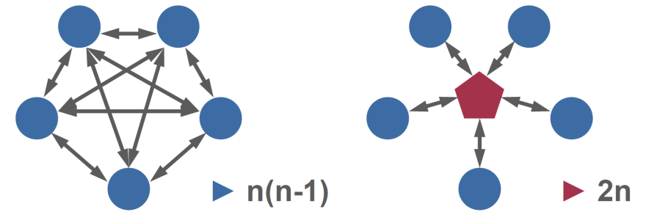















Central Standard Data - Introduction
Disciplinary Experts
Operations
Structure
Aerodynamics
On board systems
Management
Material
Propulsion
Mission performance
Flight control

Slide 4


Central Standard Data - Introduction
Disciplinary Experts
Operations
Structure
Aerodynamics
On board systems
Management
Material
Propulsion
Mission performance
Flight control
Common Parametric Aircraft Configuration Schema

Slide 5
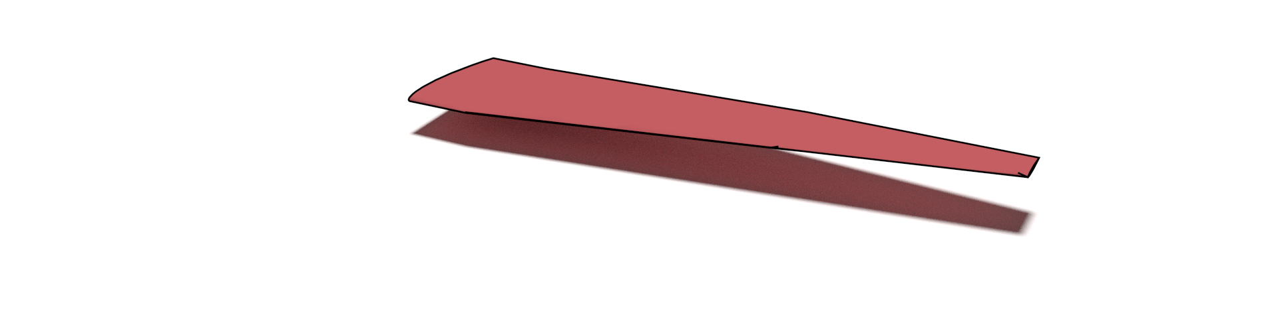
Central Standard Data - Introduction
Disciplinary Experts
Operations
Structure
Aerodynamics
ribs
On board systems
span
wing
Management
Material
Propulsion
Mission performance
Flight control
Common Parametric Aircraft Configuration Schema
Data must be explicit and unique!

Slide 6
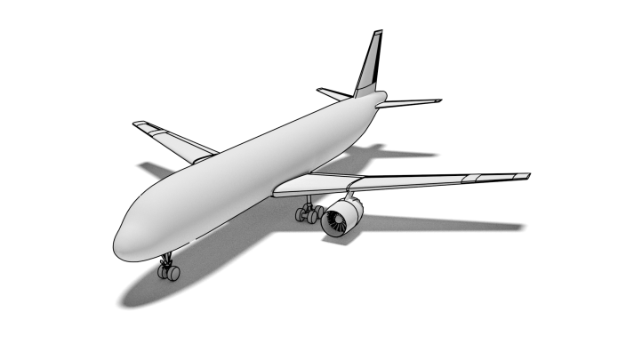
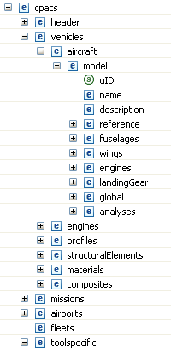
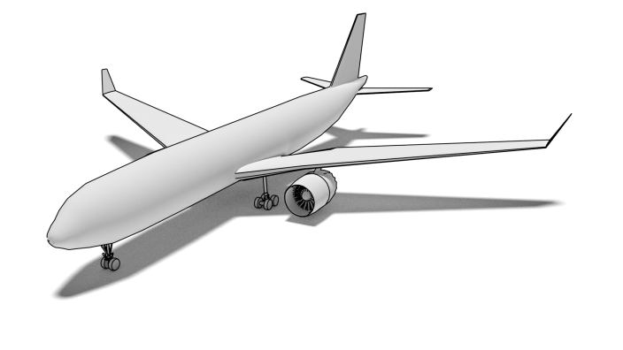
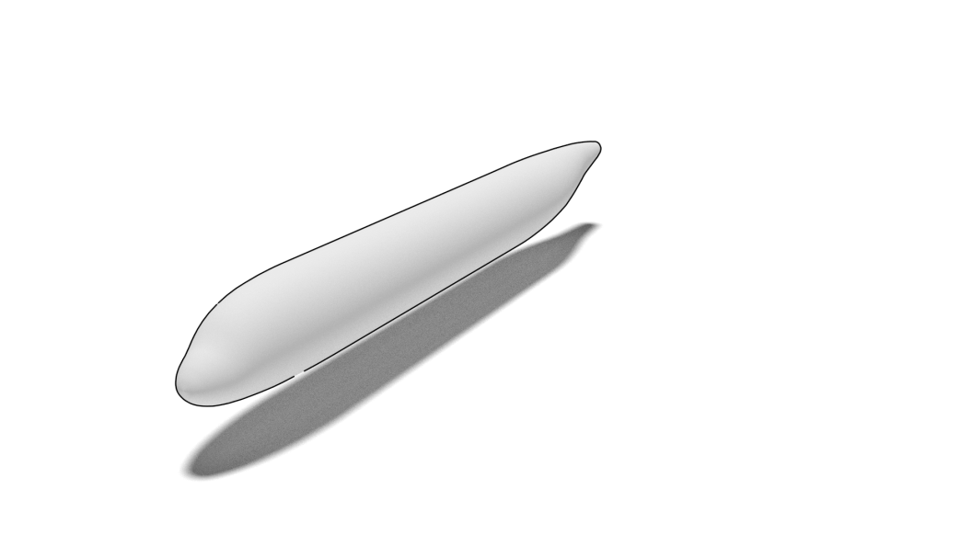
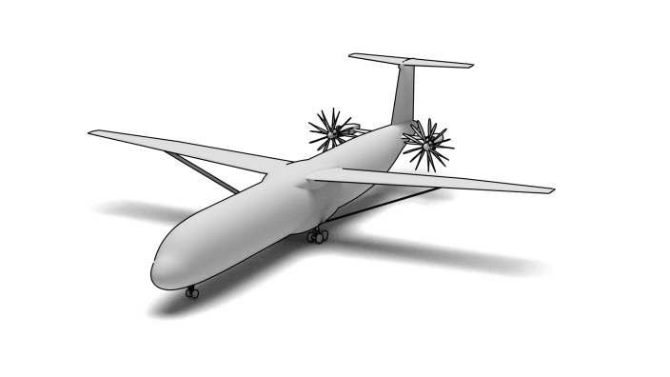
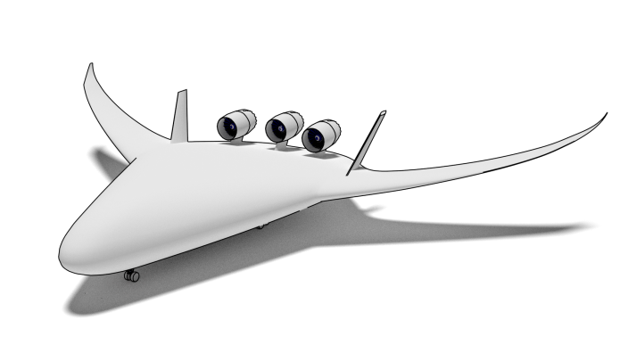
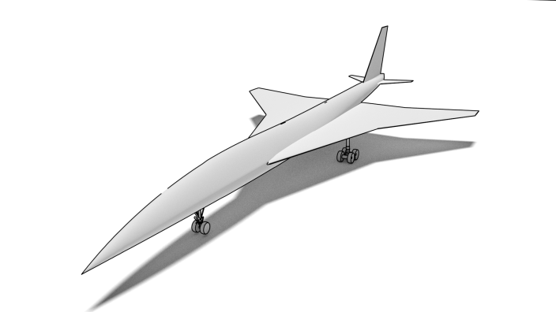
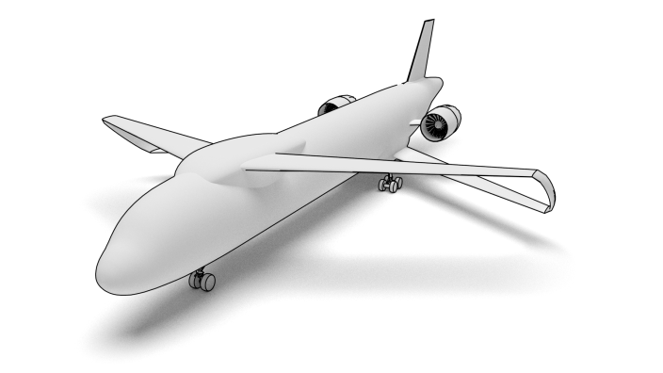
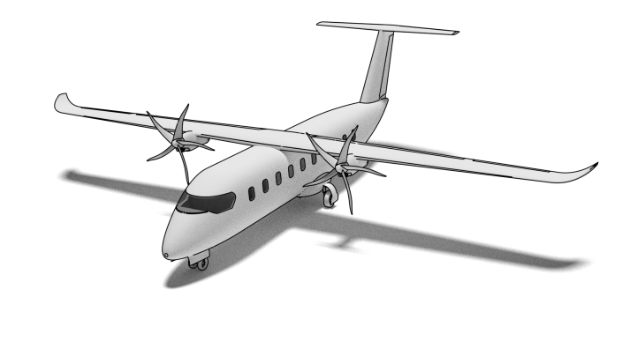
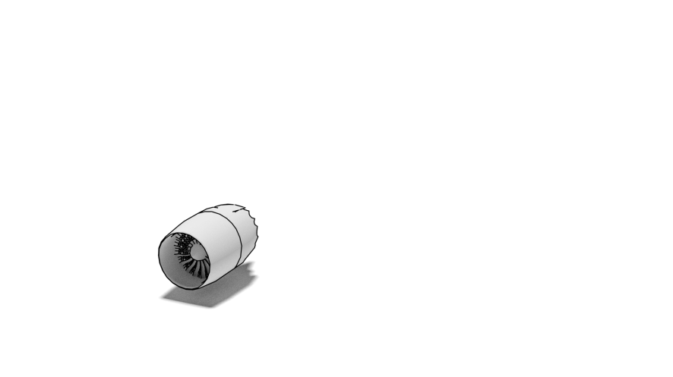
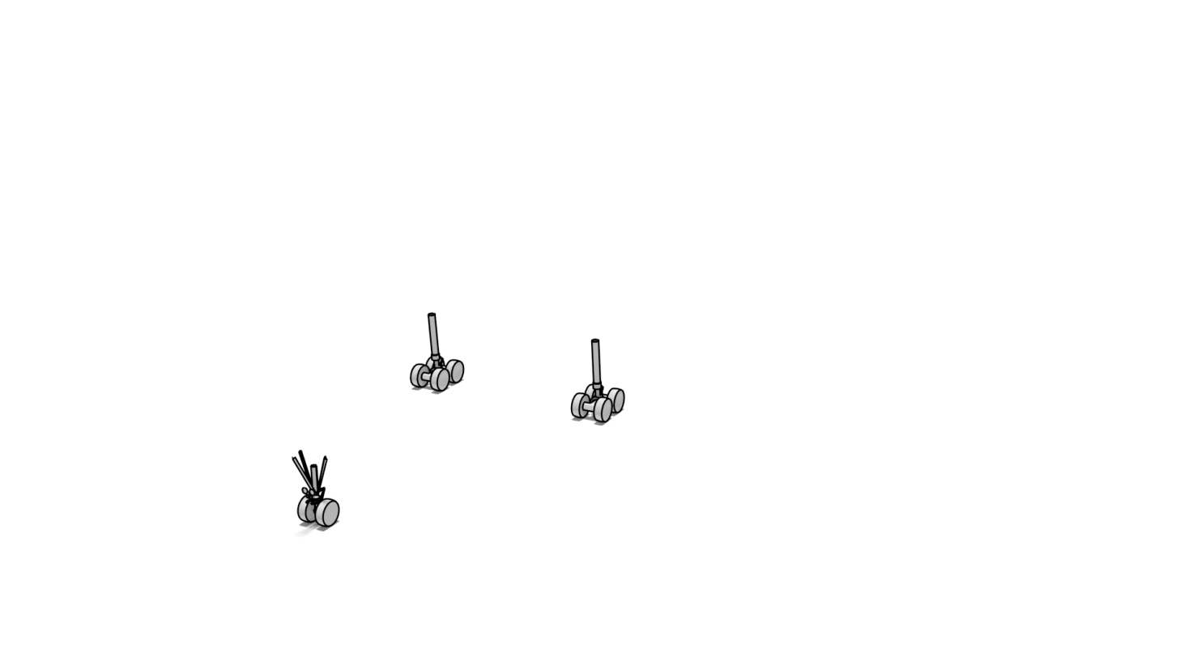
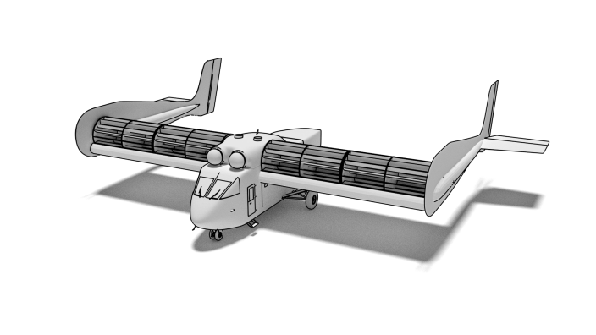
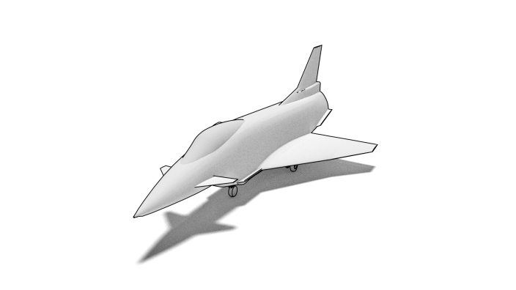
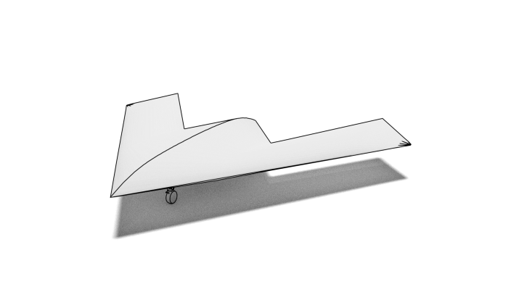


CPACS: Common Parametric Aircraft Configuration Schema
Hierarchical Structure
2. level
3. level
4. level
top level

Slide 7

CPACS: Common Parametric Aircraft Configuration Schema
Hierarchical Structure
Common language for aircraft design
Exchange of specialist knowledge
Developed since 2005, based on XML / XSD
Human readable
Standardized
Contains product and process information
Open-source
2. level
3. level
4. level
top level

Slide 8

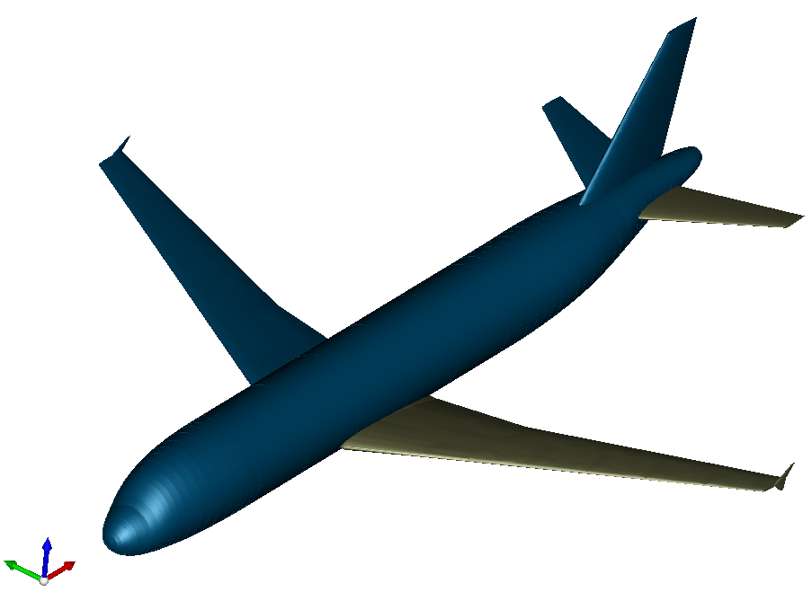
CPACS: Common Parametric Aircraft Configuration Schema
Hierarchical Structure
Common language for aircraft design
Exchange of specialist knowledge
Developed since 2005, based on XML / XSD
Human readable
Standardized
Contains product and process information
Open-source
Supporting libraries:
TIXI: fast & simple XML Interfacing
TIGL: Geometric Library (based on OpenCASCADE)
- query functions: tiglGetWingArea
- export to IGES/VTK
- geometry viewer
external interfaces for: C, C++, Python, Java, MATLAB and Fortran
2. level
3. level
4. level
top level

Slide 9





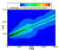
CPACS: Common Parametric Aircraft Configuration Schema
Hierarchical Structure
automate
input
select
map
existing analysis module
input
selection
input
→
2. level
3. level
4. level
top level
supporting libraries (optional)
execute analysis
file handling
geometry handling
output
updated
provide output
map
output
output
←
output

Slide 10
CPACS: Common Parametric Aircraft Configuration Schema
Hierarchical Structure
automate
input
select
map
existing analysis module
input
selection
input
→
2. level
3. level
4. level
top level
supporting libraries (optional)
execute analysis
file handling
geometry handling
output
updated
provide output
map
output
output
←
output

Slide 11
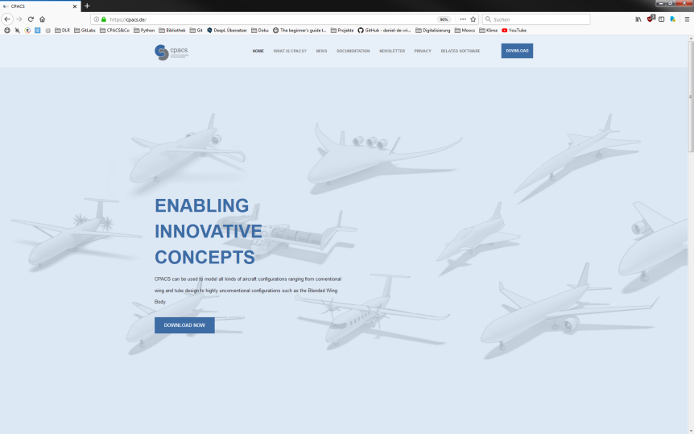
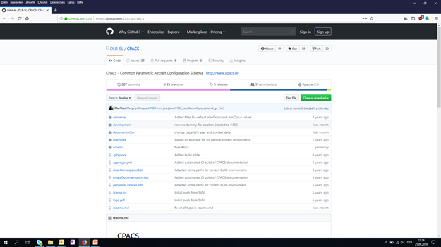
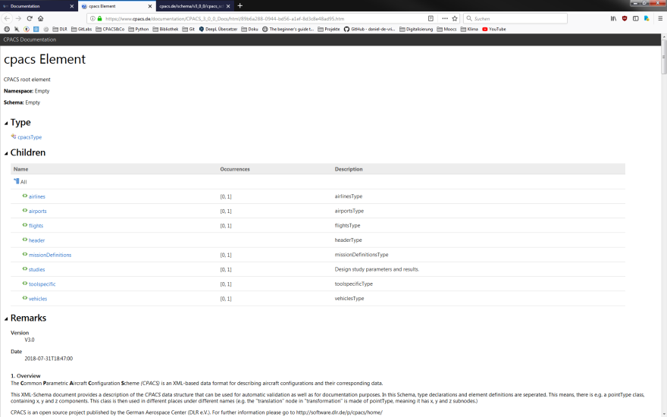
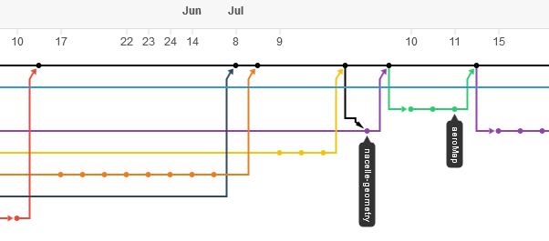


CPACS eco-system documentation, support, development
Homepage
download, news, newsletter, online help, link to other parts of eco-system
GitHub
version management, Q&A forum
https://cpacs.de
https://github.com/DLR-SL/CPACS
https://github.com/DLR-SL/CPACS_Seminar

Slide 12
How do I get CPACS?

Slide 13
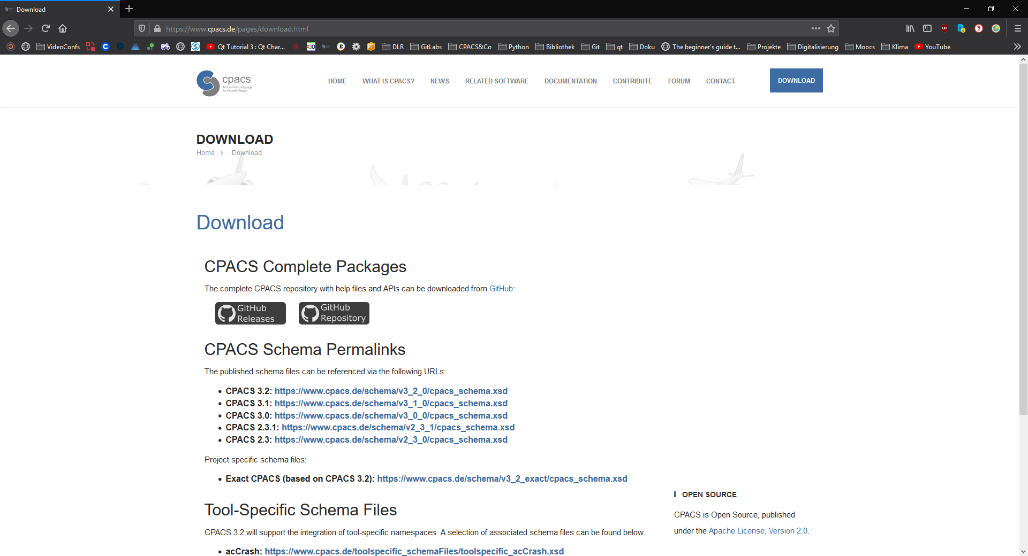
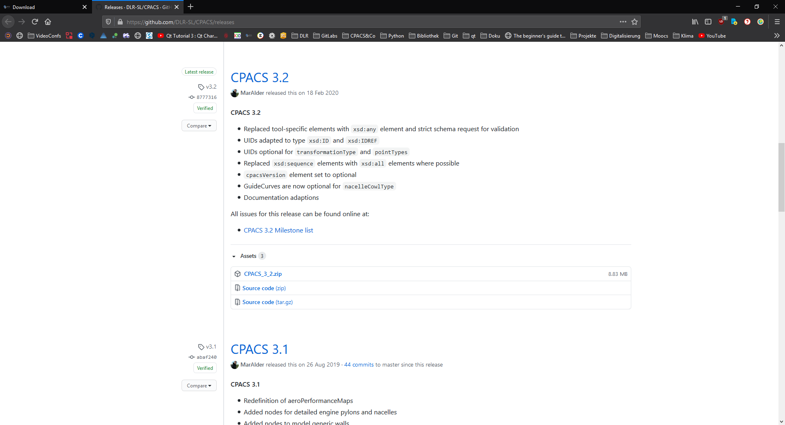
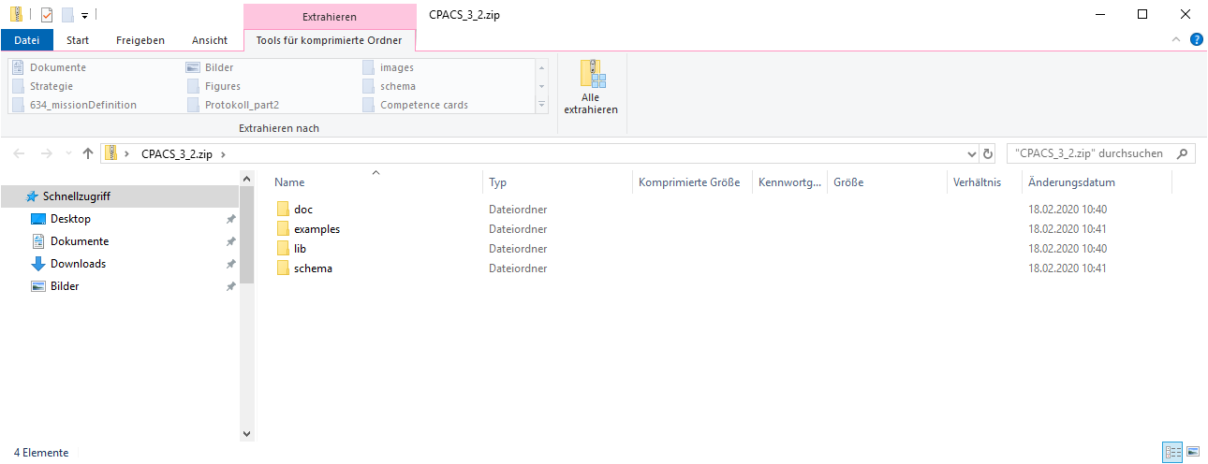
www.cpacs.de
github.com/DLR-SL/CPACS/releases

Slide 14
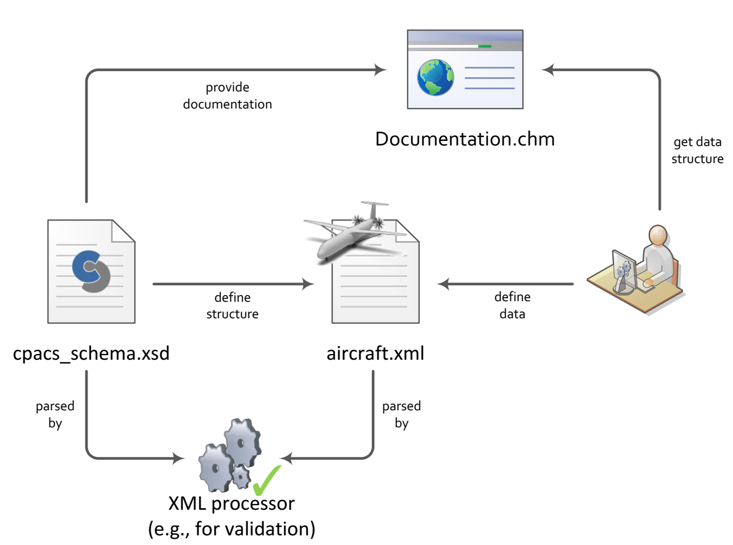
XSD and XML

Slide 15
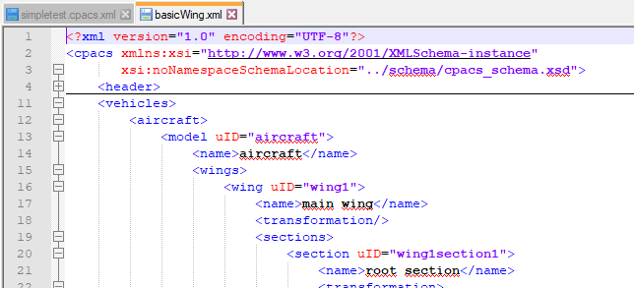
XSD and XML

Slide 16
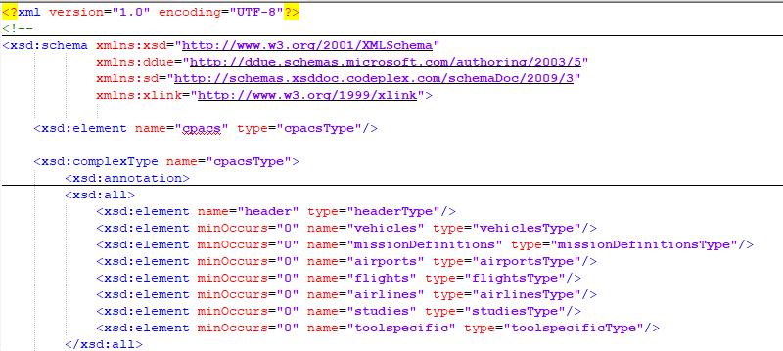
XSD and XML

Slide 17
XSD and XML

Slide 18
XSD and XML

Slide 19
How do I get data from CPACS?

Slide 20
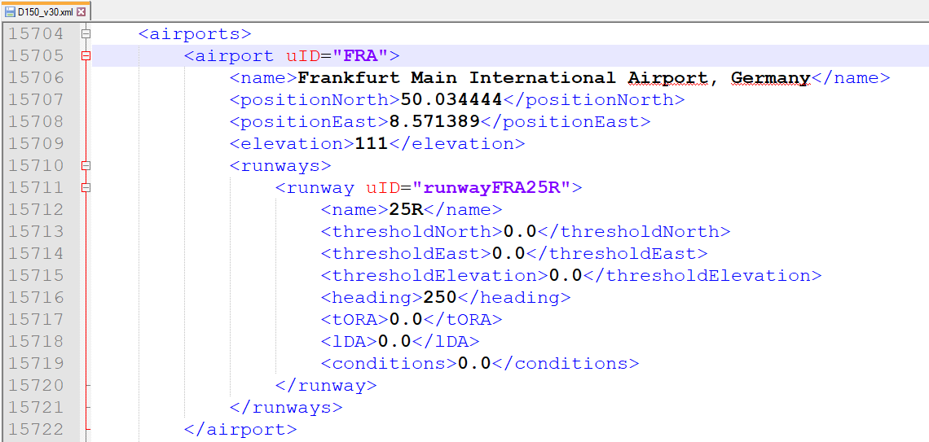
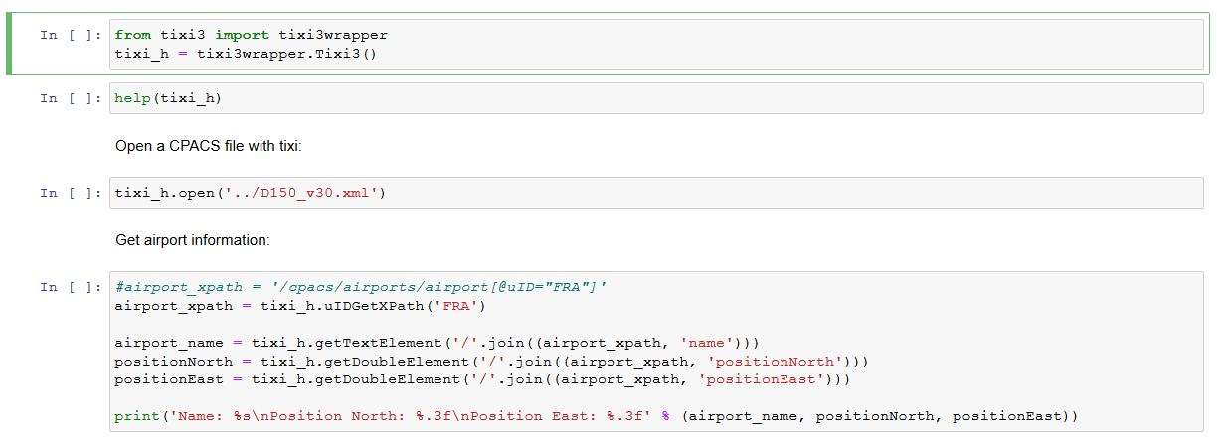

Read data with TiXI
TiXI
TiXI: TiXI XML Interface
Extends LibXML2 with individual functionalities
https://github.com/DLR-SL/CPACS_Seminar

Slide 21

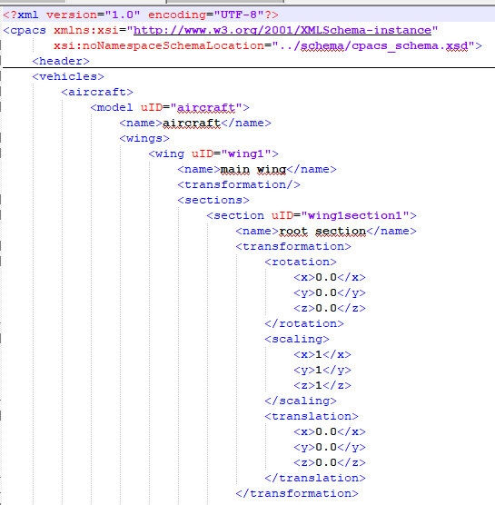

CPACS and friends ...
TiXI
TiXI: TiXI XML Interface
Extends LibXML2 with individual functionalities
Tool integration framework
Supports data exchange via CPACS files
Aircraft data ontology
Schema: XSD
Data: XML
TiGL: TiGL Geometry Library
Based on OpenCascade
(Additional) methods for geometric operations
Viewer

Slide 22
Where to find data in CPACS

Slide 23
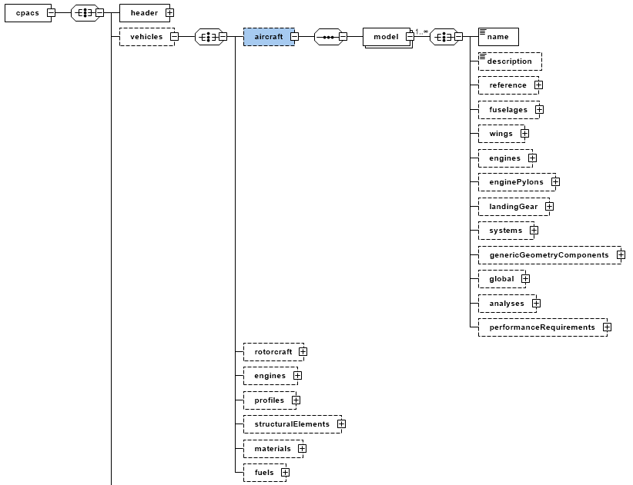

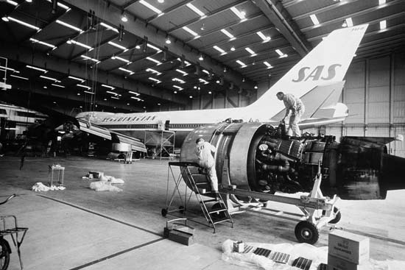
geometric models
library

Slide 24
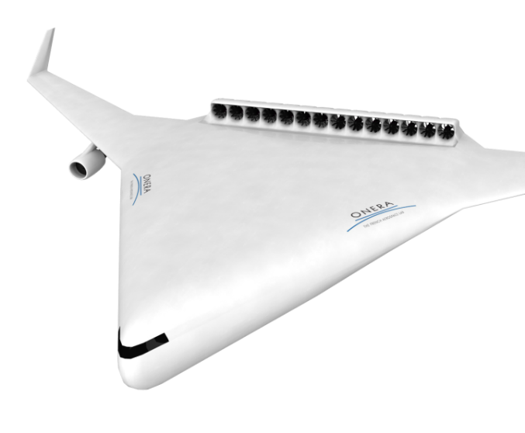
fuselage
wing
wing
wing
landingGear
landingGear
engine
engine
engine
engine
engine
engine
engine
engine
engine
engine
engine
engine
…
library

Slide 25
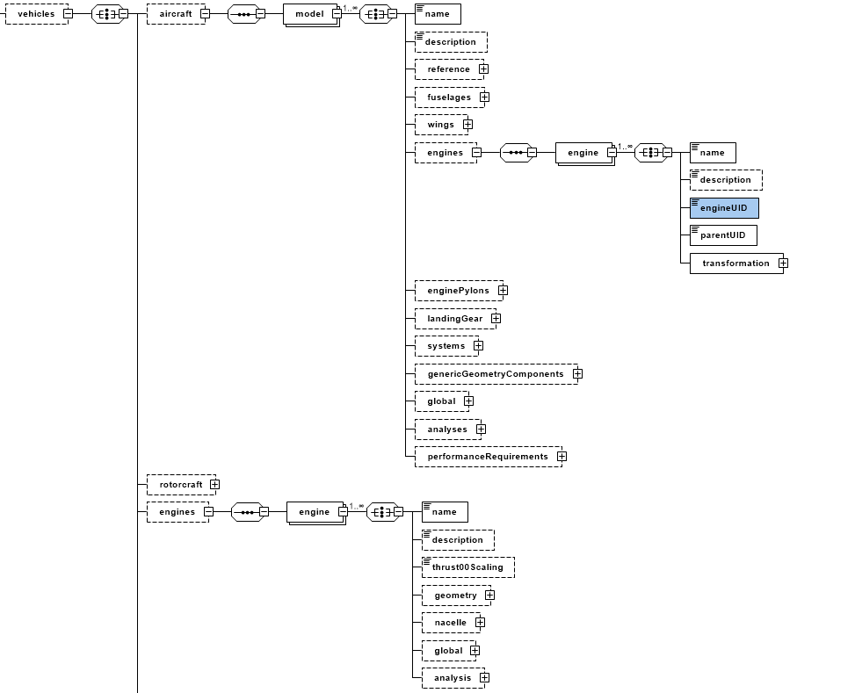
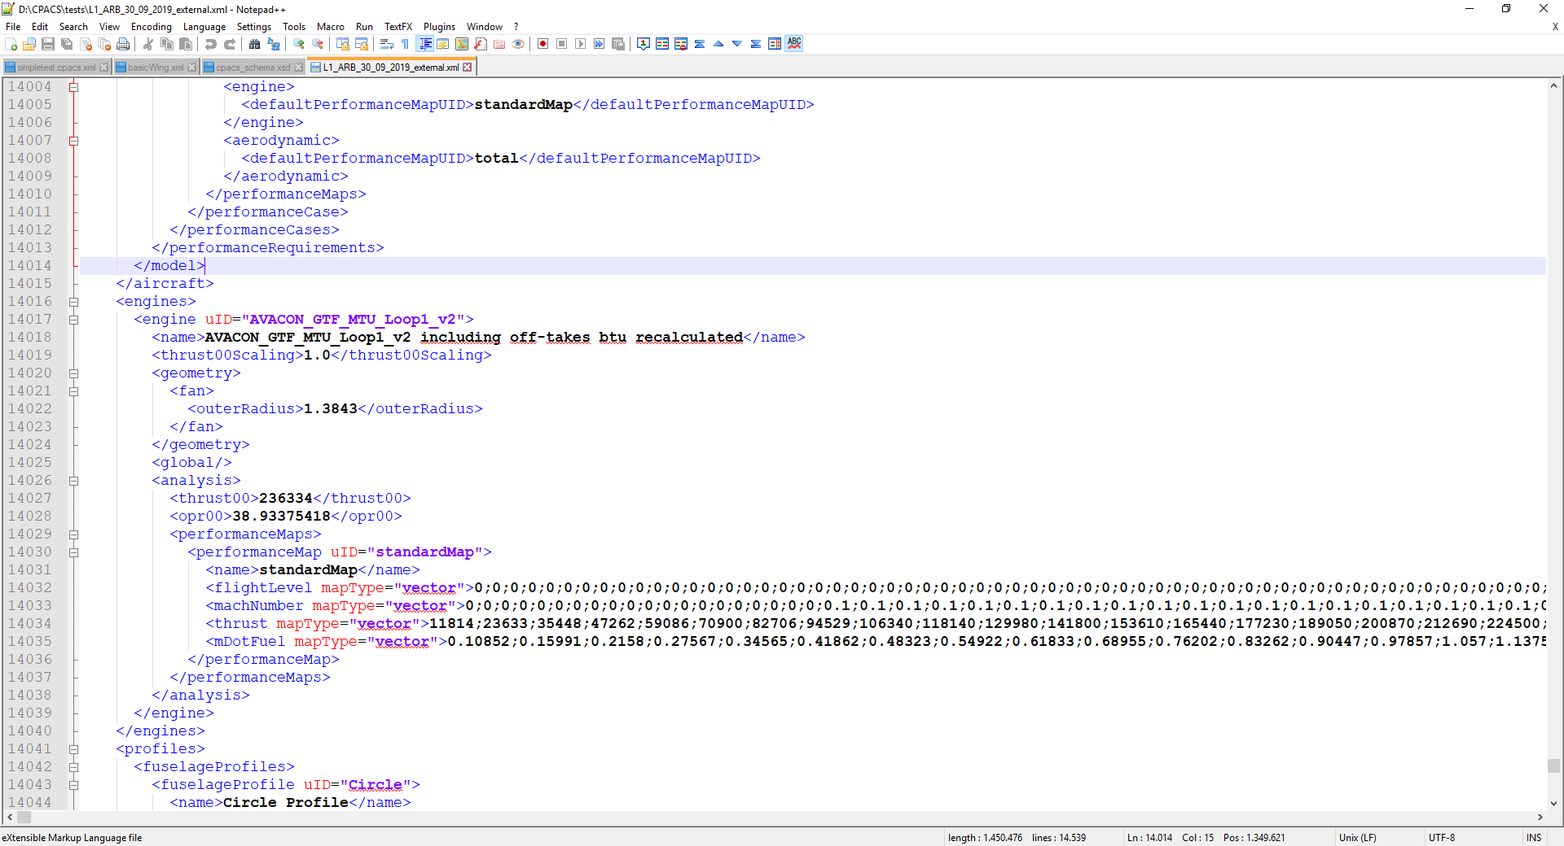
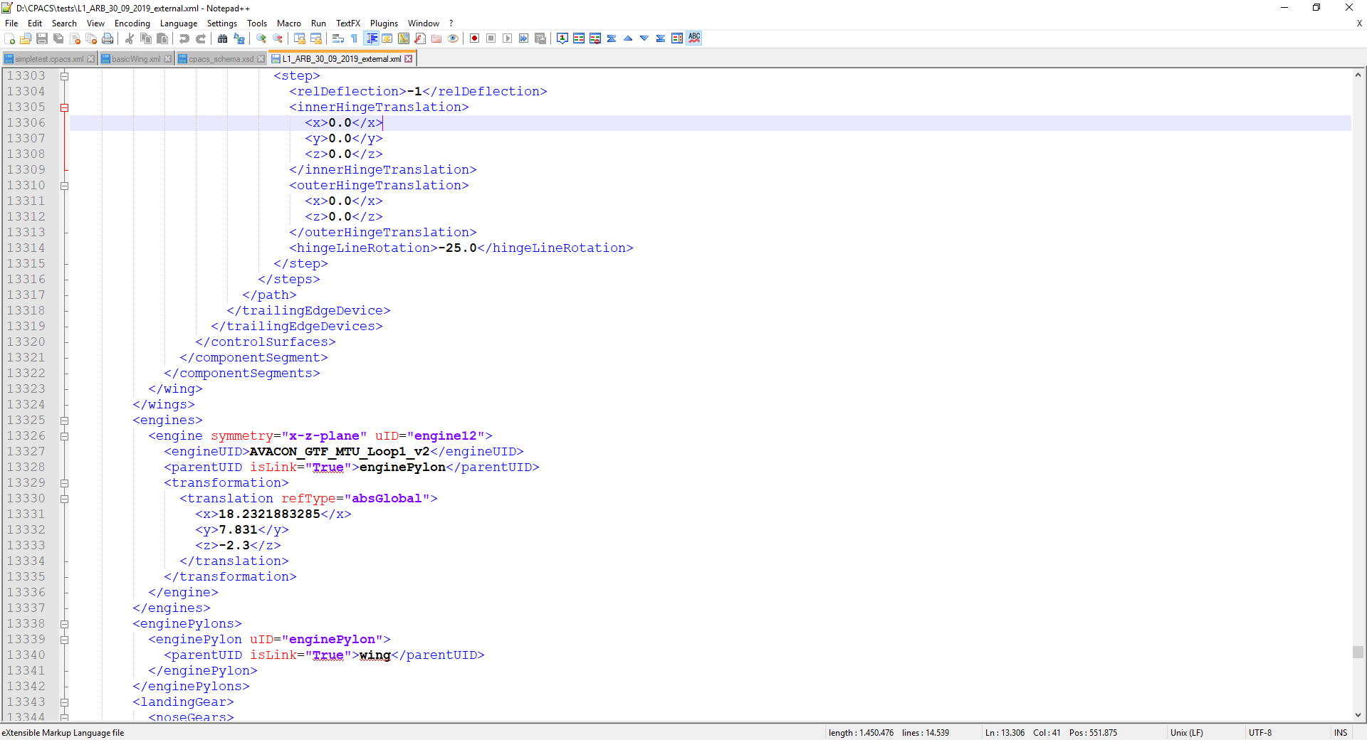
fuselage
wing
wing
wing
landingGear
landingGear
engine
engine
engine
engine
engine
engine
engine
engine
engine
engine
engine
engine
…
library / subsystem

Slide 26
geometric models
High-level analyses results
Detailed analyses based on geometric model
library

